Slide 1
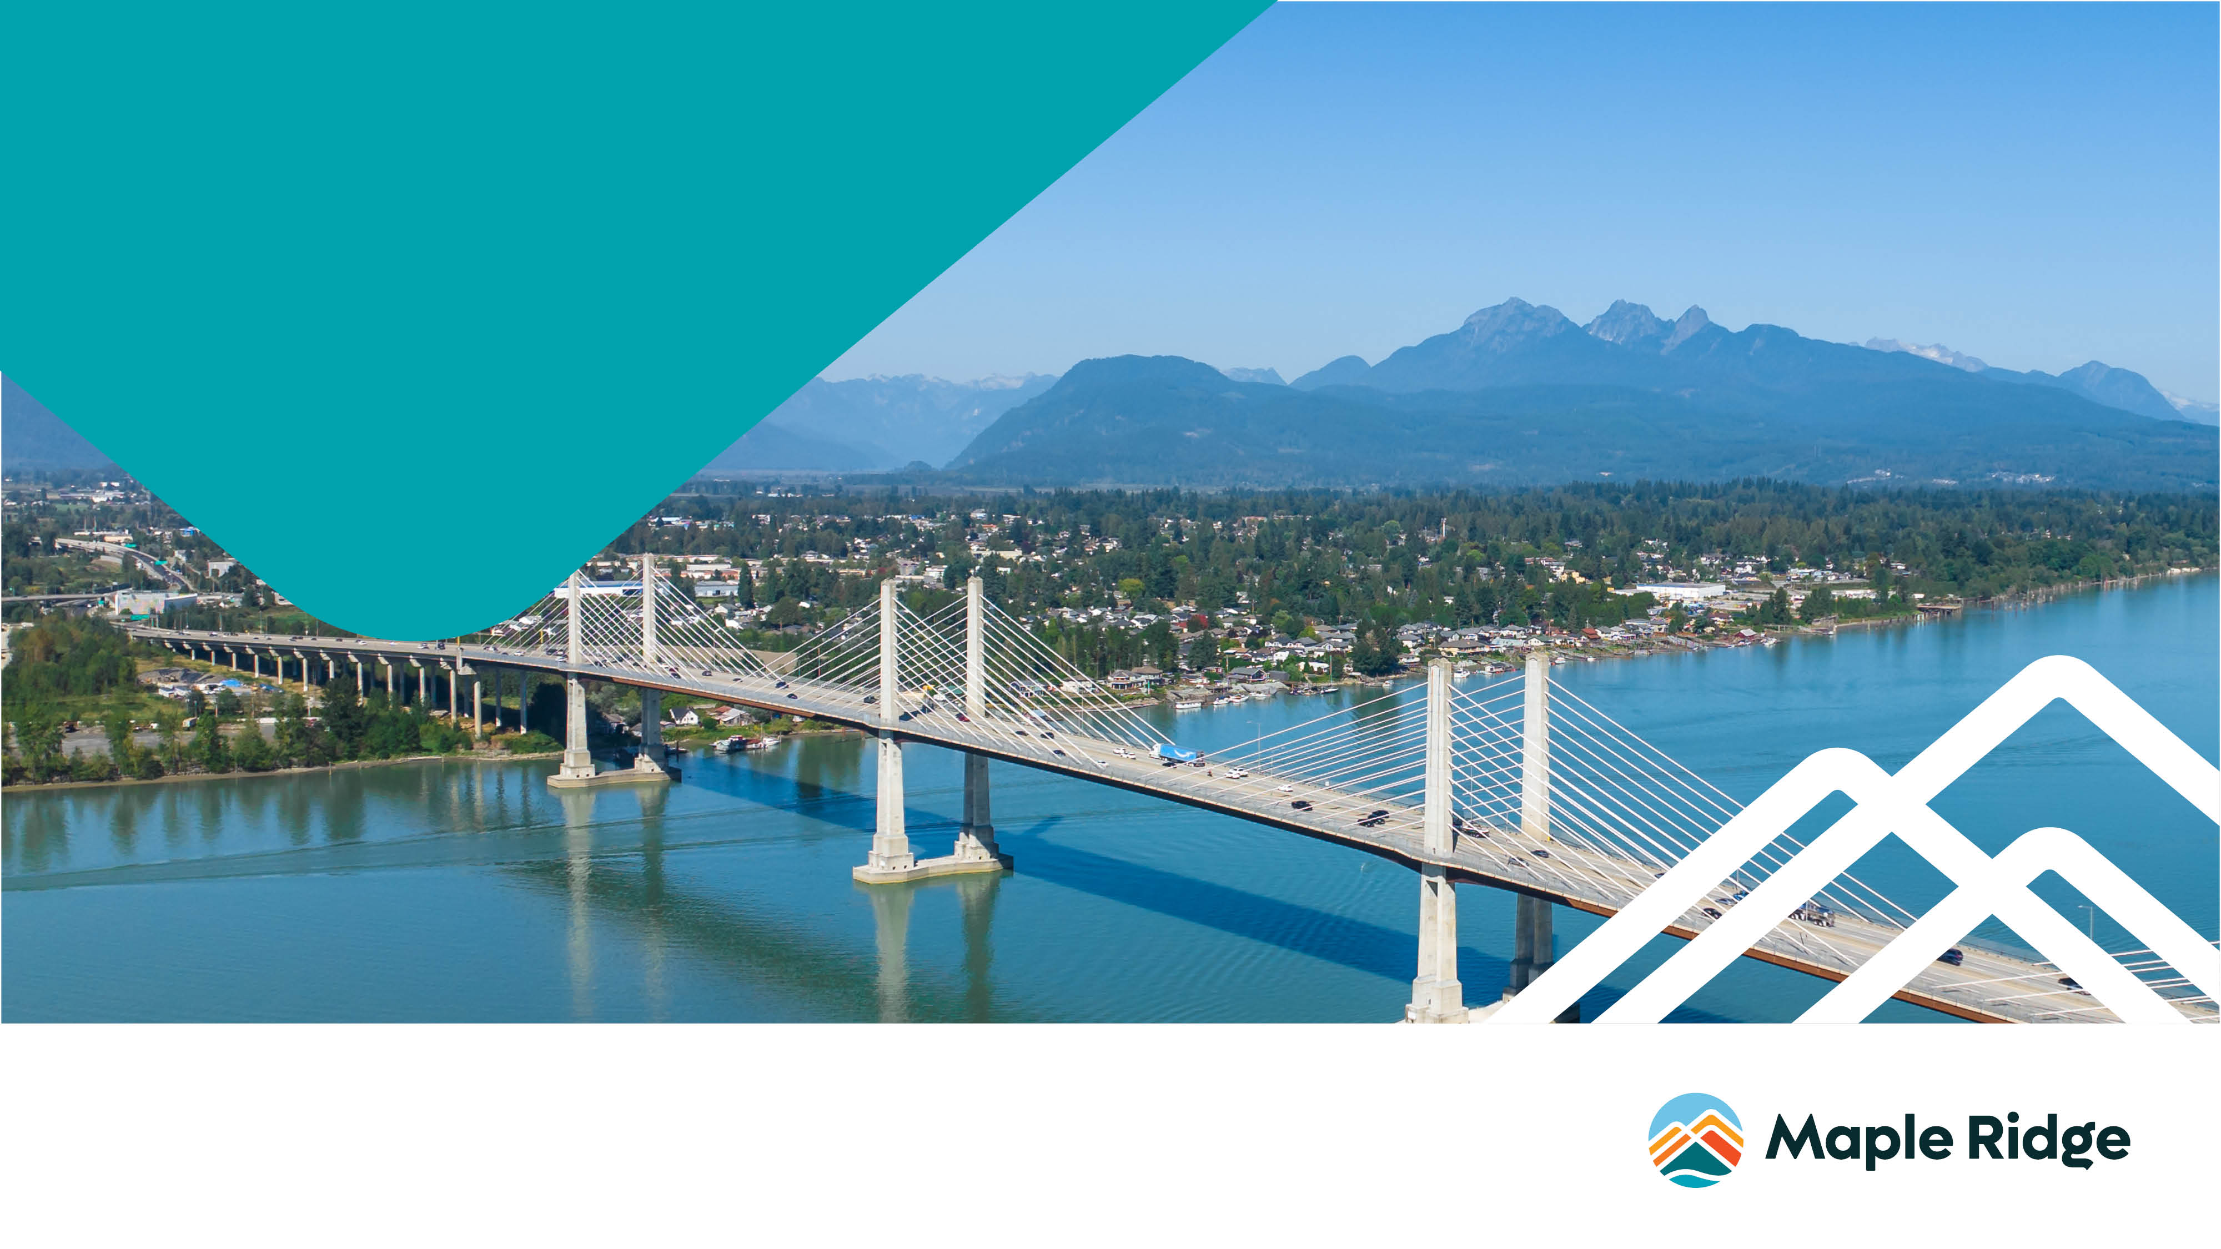
^{April 10, 2024}
WELCOME
^{Maple Ridge}
^{Zero Carbon Building Forum}

Slide 2



^{Welcome}
The City of Maple Ridge carries out its business on the traditional and unceded territories of the Katzie (q̓ic̓əy̓) First Nation and the Kwantlen (qʼʷa:n̓ƛʼən̓) First Nation.
Notes:
Welcome
Grab tables and refreshments
Land acknowledgement
Get to why we are here

Slide 3
^{Tonight}
  Provide information on the Zero Carbon Step Code (ZCSC)
  Engage building and development community
  Seek feedback on introduction of ZCSC in Maple Ridge

Slide 4


^{Background}
Province updated BC Building Code on May 1, 2023
  Requires 20% better energy efficiency of new buildings through BC Energy Step Code
  Introduced Zero Carbon Step Code (ZCSC) to reduce or eliminate carbon emissions in new buildings.
Mayor’s Taskforce on Climate Action (September to April 2024)
  Formed to look at and recommend priority actions for climate action in Maple Ridge
  Looked at Zero Carbon Step Code and BC Energy Step Code for new buildings
  Engage with building and development community
Notes:
Energy Step Code has been around since 2018, updates brings it to higher tier for energy efficiency – 20%
Zero Carbon Step Code was introduced in 2023.

Slide 5

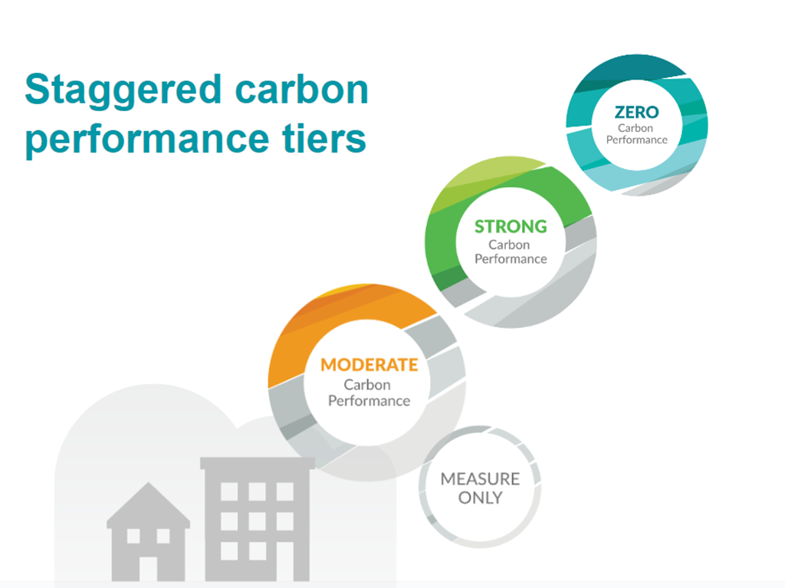
Notes:
Tonight we have two speakers who will provide details on Zero Carbon Step Code
Quick overview focus is on Zero Carbon Step Code
New tool introduced in BC Building Code update
Focus only new builds
4 carbon performance tiers – 2 pathways – performance and prescriptive
Focus on indoor heating, cooling and cooking to reduce carbon emissions

Slide 6

Introducing Zero Carbon Step Code to Maple Ridge
Part 3 residential and Part 9 residential new construction
A proposed timeline is:
Strong Carbon Performance (EL-3) by January 1, 2025
Zero Carbon Performance (EL-4) by January 1, 2026
Part 9 Residential Buildings – Both prescriptive and performance pathways
Part 3 Residential Buildings – Performance pathway
Notes:
Proposed timelines and levels, not set in stone
Looking for feedback
BC Energy Step Code follows Province timelines
These timelines align with other Metro Vancouver municipalities that have introduced Zero Carbon Step Code for Part 9 buildings (EL-3 to EL-4 in 2023 to 2025) and Part 3 buildings (EL-2 to EL-4 in 2023 to 2025).

Slide 7
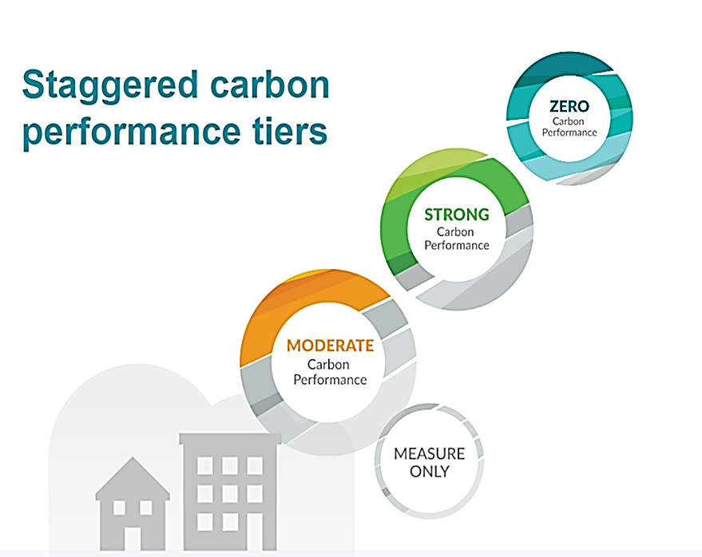
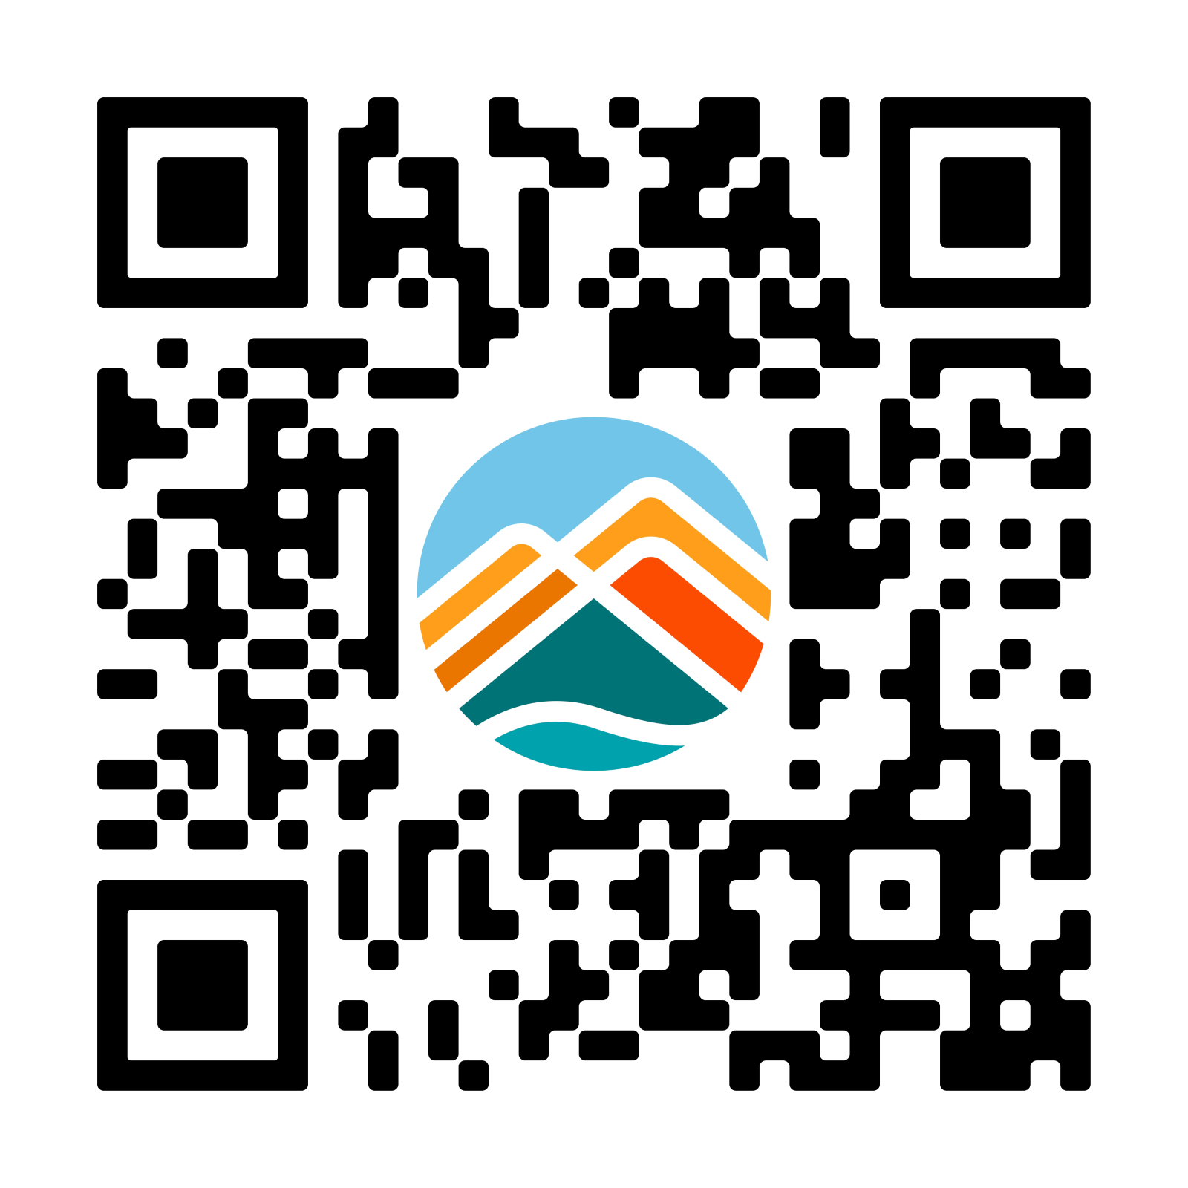
^{Survey}
Survey QR Code
2026
Proposed timeline
2025
2024
Notes:
Launched a feedback survey and information page on Engage Maple Ridge
Encourage you to submit feedback
Survey launches tonight (April 10th and runs until April 24)
Reminder these are proposed timelines, feedback informs the report to Council on a pathway moving forward.

